Slide 1





Any question please contact
info-canberra@win.edu.au

Slide 2












LOGIN PAGE: https://win.portal.edulab.cloud/account/login
USERNAME: Your Student ID @win.edu.au
PASSWORD: Password of Student Email

Slide 3






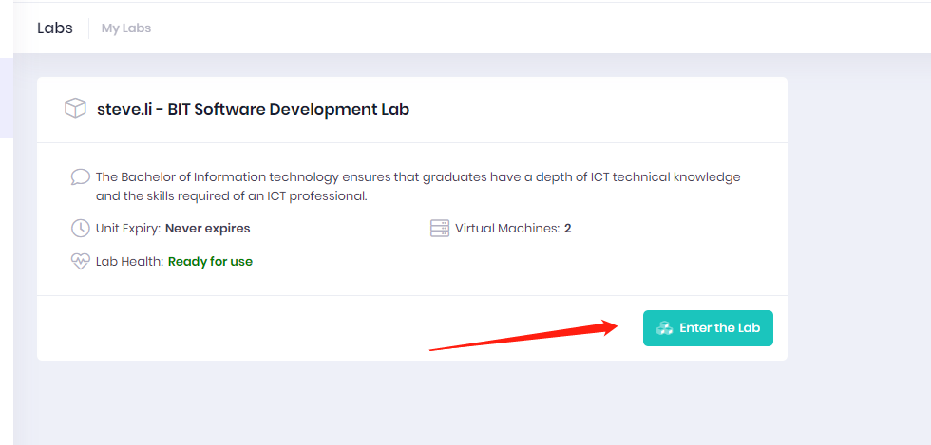
Step 1
Once you login to edulab, click the enter the lab to choose workstation.

Slide 4



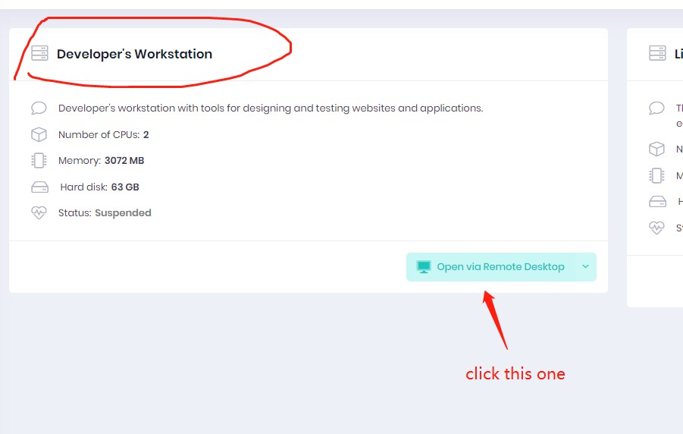
Click on the button on Developer’s workstation, this is your main workstation to do your work.

Slide 5
Step 3
You need to Power on, copy password, and download the RDP File.

Slide 6
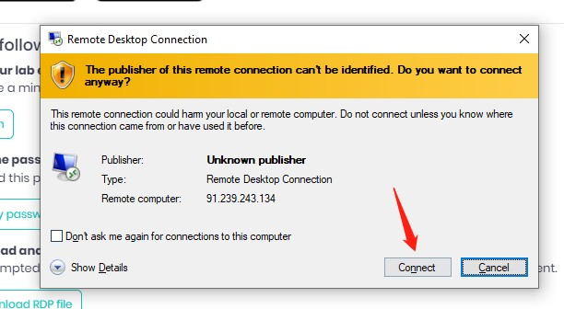
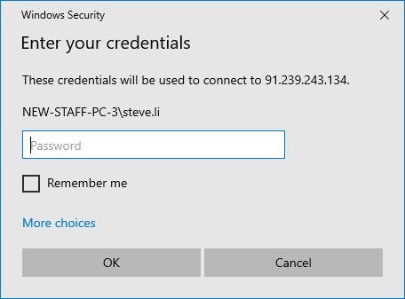
Enter the password, you had copy on the previous step

Slide 7
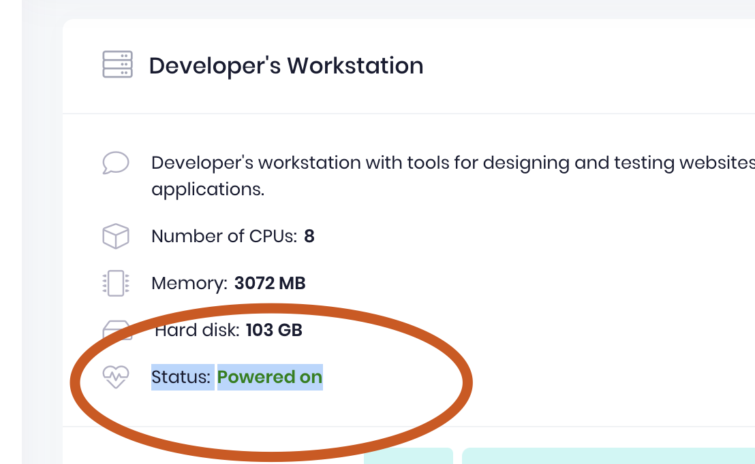
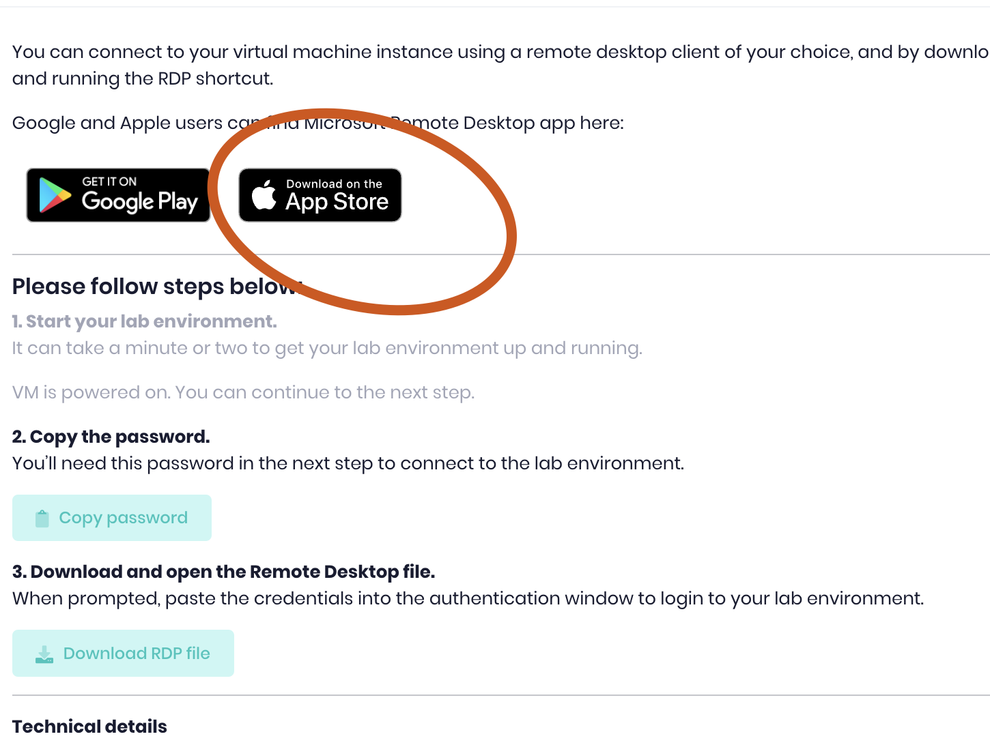
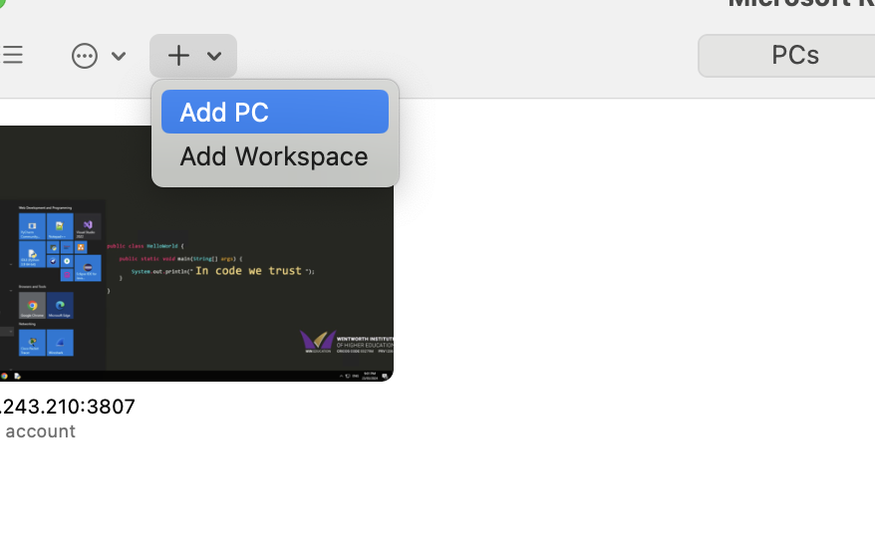
MAC OS:
Step1: power on
Step2: Download app
Step3: Open App and Add pc

Slide 8
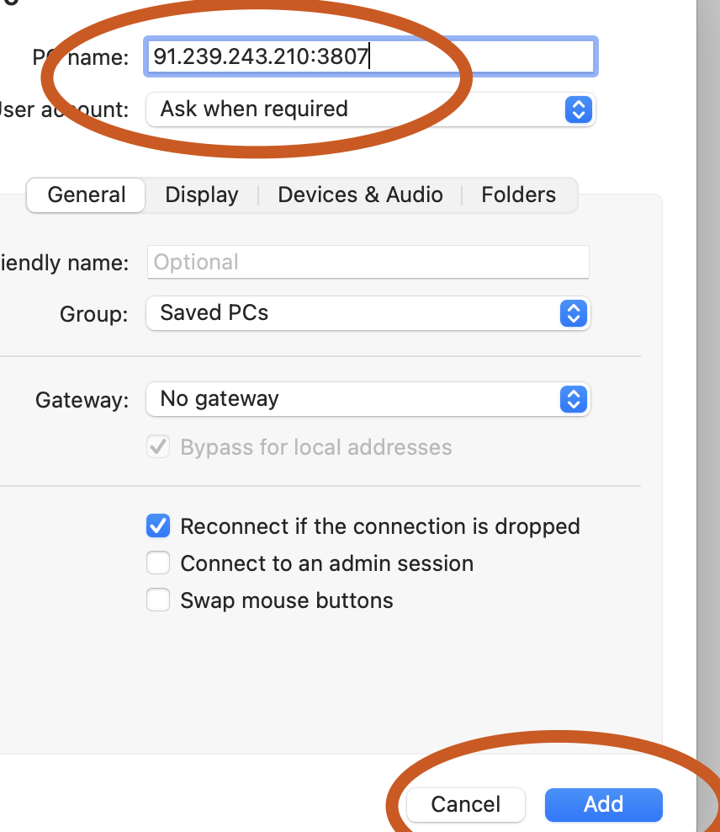
MAC OS:
Step4: input ip and click ADD
Step5: Waiting and input your username and password

Slide 9
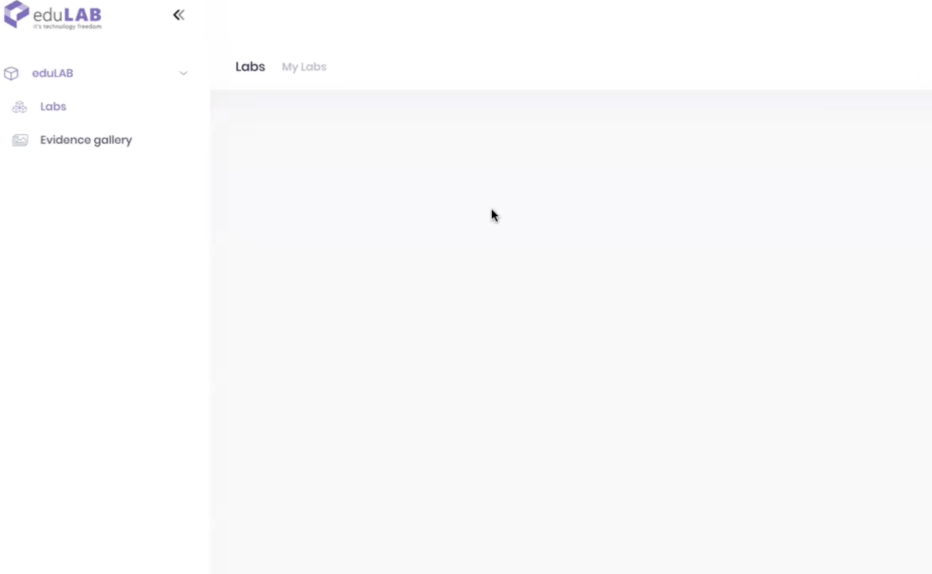
Other Issues:
1. BlankPage give your student id to Zack. Fix this problem need 2 days.

Slide 10
Once you had see the page like this, you had successfully get into the edulab.
Take evidence button can help you capture your screenshot to teacher check your work on the edulab
Press the button every time when you done you work!!! So teacher can see what you do!!!

